Slide 1
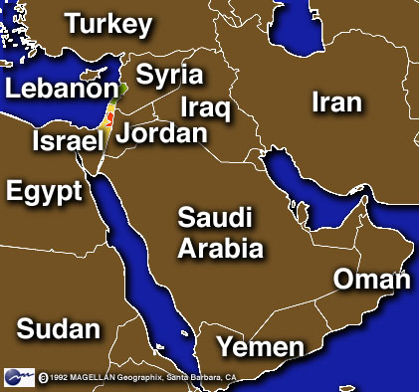
Central and Southwest Asia
Chapter 21

Slide 2
Historical Overview
Page 439 Map
Fertile Crescent
Agricultural Revolution
Birthplace of civilization
Stretching from modern Iraq to Israel
8000 B.C. hunters and gatherers first began to raise plants and animals for food

Slide 3
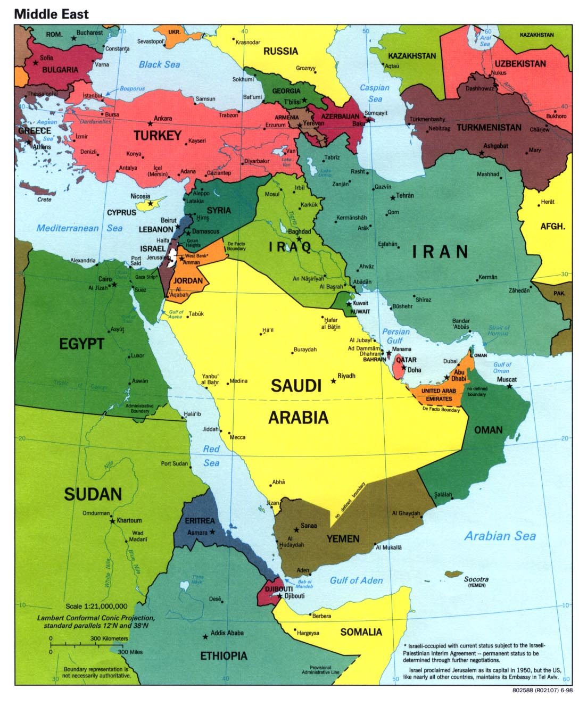
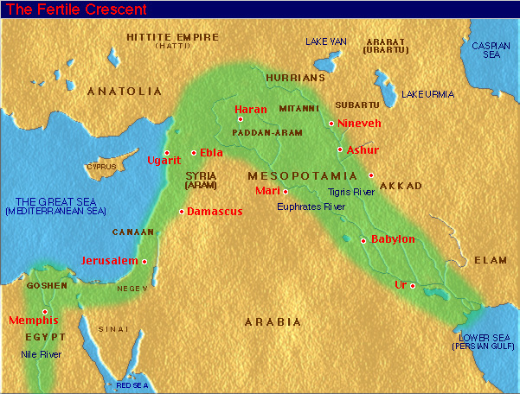
Map of Fertile Crescent

Slide 4
Religion
Three major religions began in this region:
Judaism – 2000 B.C.
Monotheism – belief in only one god
1000 B.C. founded a kingdom called Israel
Christianity – 2000 years later, based on teachings of Jesus
Islam – Between A.D. 632 and 714 they gained control of most of Central and Southwest Asia

Slide 5
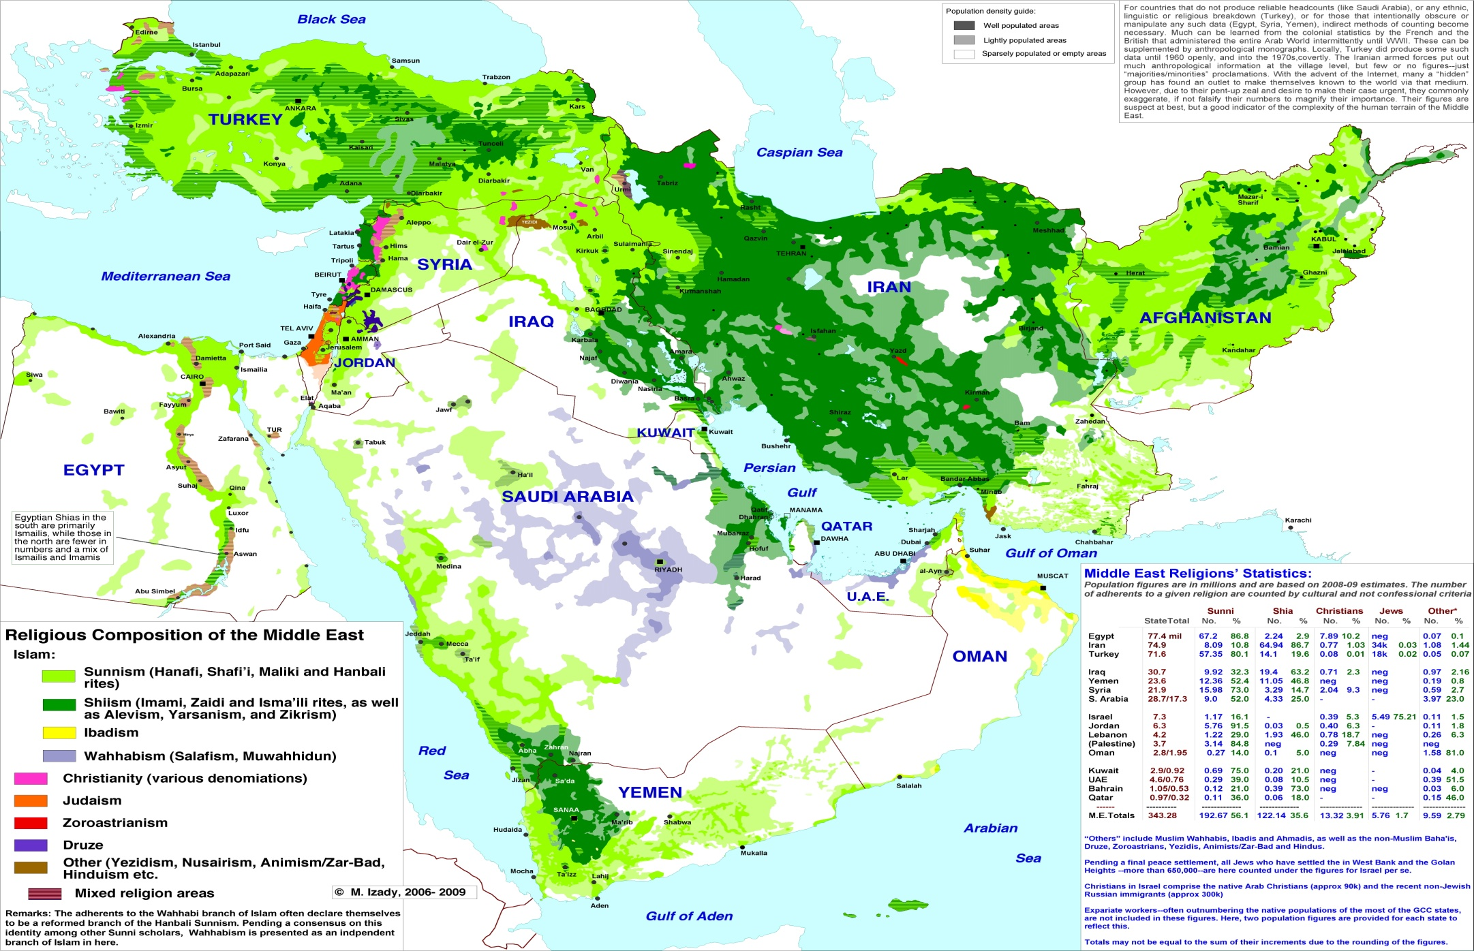
Map of Religions

Slide 6
European Imperialism
After World War I, European powers divided it into a number of nations and protectorates
Areas that have their own government but are controlled by an outside power

Slide 7
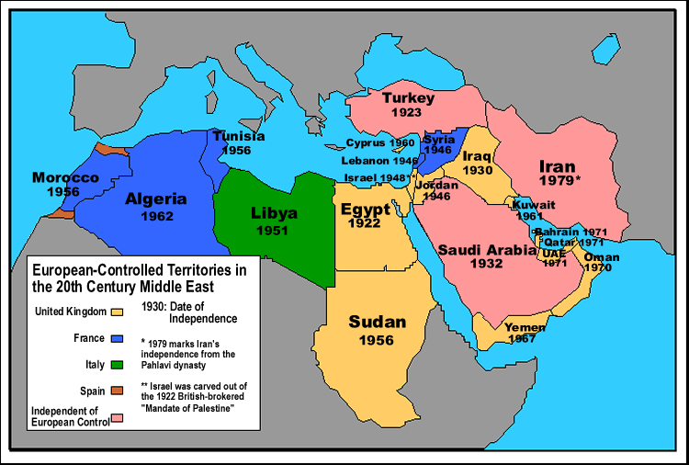
Map of European Imperialism

Slide 8
Physical Characteristics
Page 441 Map
Towering mountains and vast, arid plains
Deserts cover most of plains except where the rivers flow
Kara Kum and Kyzyl Kum – two of worlds greatest deserts found in Central Asia

Slide 9
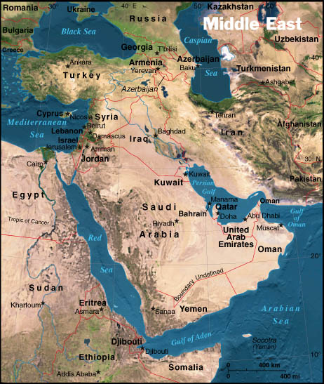
Map of Physical Characteristics

Slide 10
Aral Sea – landlocked salt sea
Water diverted upstream by soviets to irrigate farmland, leaving salt flats
Tigris River – vital but limited water source

Slide 11
Climates
Page 443 Map
Desert ecosystem
Chaparral – drought-resistant herbs and bushes
Mountains and coastal regions have cool, wet winters and warm, dry summers

Slide 12
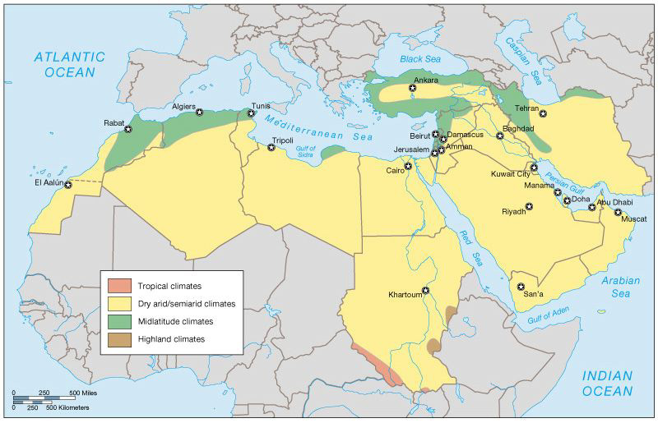

Slide 13
Ecosystems
Page 445 Map
Mainly desert ecosystems
Areas with slightly higher rainfall support temperate grasslands.
Forests grow near mountains and rivers
Caspian Sea – worlds largest inland body of water

Slide 14
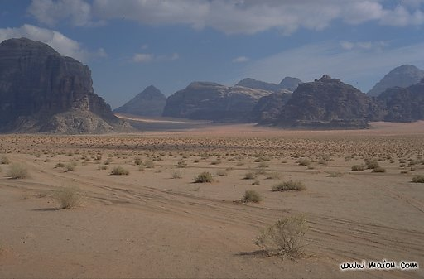
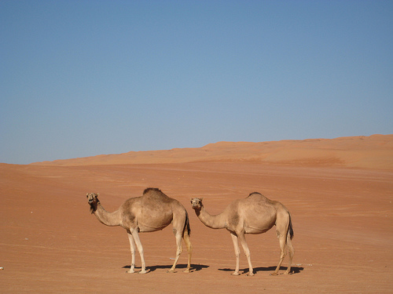
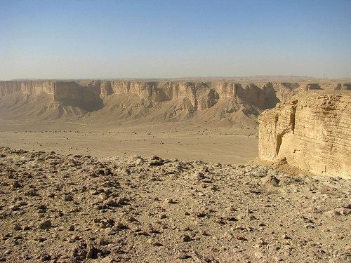
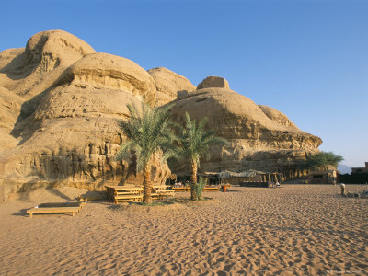

Slide 15
People and Cultures
Page 447 Map
Rich cultural history
Judaism, Christianity, and Islam all developed in this region
Most people of the region are MUSLIM

Slide 16
Traditional culture – nomadic livestock herders have lived in moveable tents called yurts
Supplement income by making fine carpets and rugs
Nomads – people who travel from place to place
Islamic Worship –
Mosques – Islamic places of worship
Five times each day, a muezzin, or crier, climbs the minaret, the tower attached to the mosque, to call the people to prayer.

Slide 17
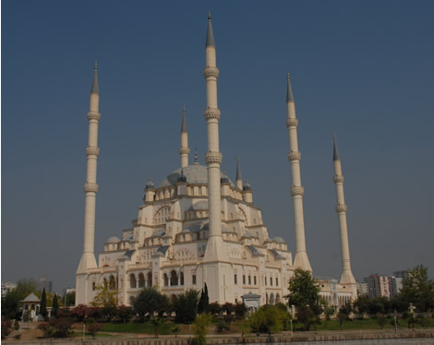

Slide 18
A Holy City
Jerusalem is sacred to members of three religions.
Jews consider it the site of the ancient kingdom of Israel
Christians, it is the place where Jesus was crucified
Muslims believe that Muhammad visited heaven from Jerusalem
Reason for much struggle

Slide 19
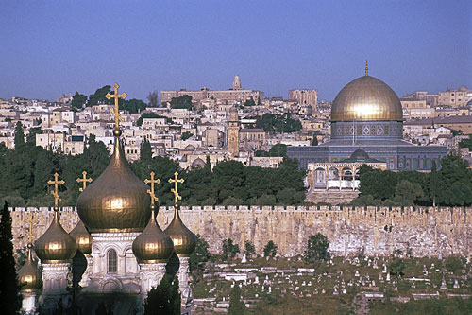

Slide 20
Economy
Page 449 Map
Large portion of land is used for livestock raising and nomadic herding, but majority of people live in urban areas
Services and industry are main activities
Areas of subsistence and commercial farming in areas of fertile soil
Petroleum and natural gas $$$

Slide 21
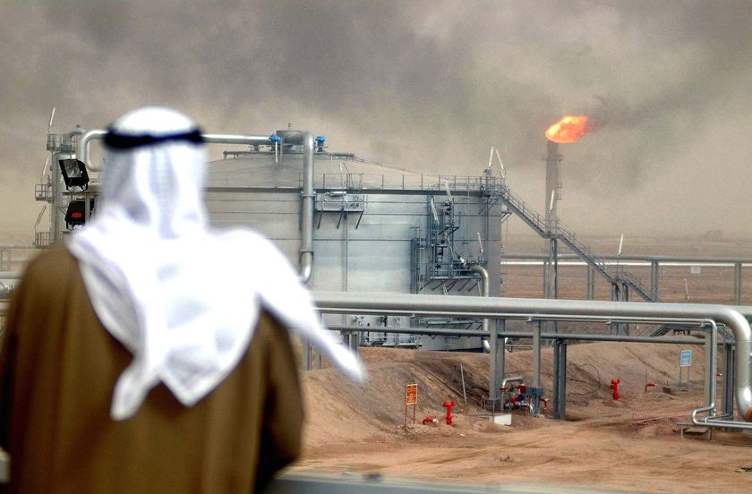
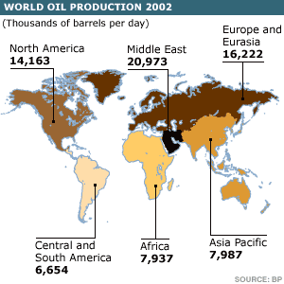

Slide 22
Technology
Lack of fresh water
Desalination plants – evaporate seawater to obtain fresh water

Slide 23
